Slide 1

IMPROVING INTELLIGIBILITY OF DYSARTHRIC SPEECH
Term Project (ET60029)
Team Transformers
Guide: Professor Manjira Sinha
ET60029

Slide 2
ET60029
Team Members
Name | Roll No
Gunda Venkata Shanmukha Sainath | 19EC10026
B Sai Vamshi | 19CS10016
Jayanth Yindukuri | 19CS10068
D G Pranathi | 19CS10025
Aggi Sahithi | 19ME10004
Dhanush Kumar Reddy | 19EE10024

Slide 3
ET60029
INTRODUCTION
PROBLEM STATEMENT
APPROACH
GAN MODELLING
DEPLOYMENT

Slide 4

INTRODUCTION

Slide 5
ET60029
Dysarthria:
Dysarthria refers to a group of speech disorders resulting from disturbances in muscular control of speech mechanism due to a damage in the central or peripheral nervous system.
Dysarthria occurs when the muscles you use for speech are weak or you have difficulty controlling them.
Symptoms include slow voice, slurred voice, rapid speech, monotone speech, uneven speech volume and strained voice
Because of the communication problems dysarthria causes, complications can include:
Social difficulty. Communication problems may affect your relationships with family and friends and make social situations challenging.
Depression. In some people, dysarthria may lead to social isolation and depression.
Intelligibility:
Intelligibility is a measure of how comprehensible speech is in given conditions.

Slide 6
PROBLEM STATEMENT

Slide 7
ET60029
To improve intelligibility and comprehensibility of dysarthric speech.
Using Machine Learning approach to transfer characteristics of normal speech to dysarthric speech.

Slide 8
APPROACH

Slide 9
ET60029
Training a GAN based DL model (with dysarthric and control voices) which when given a dysarthric voice, converts to non-dysarthric voice during inference
Deploying the model on webapp for live usage (with upload and download options)

Slide 10
GAN MODELLING

Slide 11
ET60029
Dataset:
There are many publicly available datasets of dysarthric speech.
TORGO Database
UASpeech Database
Dataset mainly contains following
Audio samples of person with Dysarthric voice (Dysarthric speaker)
Audio samples of person with Normal voice (Normal speaker)
All digits, letters, common words and Uncommon words are recorded
We will be using TORGO Dataset for our project. Data structure is as follows
dysarthria_female :Female Dysarthric speech files (500 wav files)
non_dysarthria_female : Female Control speech files (500 wav files)
dysarthria_male : Male Dysarthric speech files (500 wav files)
non_dysarthria_male : Male Control speech files (500 wav files)

Slide 12
ET60029
Data Preprocessing:
Audio signal is converted into wideband spectrogram using Short-Time Fourier Transform (STFT) with windows of 512 frames and 33% overlap.
Converted to wideband spectrograms ranging from 100-200Hz, which allows for high quality output in the time resolution.
Spectrogram is then converted to dB amplitude scale and saved as grayscale image.
Finally the obtained gray-scale image is converted to RGB image and resized to 256x256x3 image

Slide 13
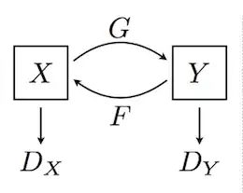
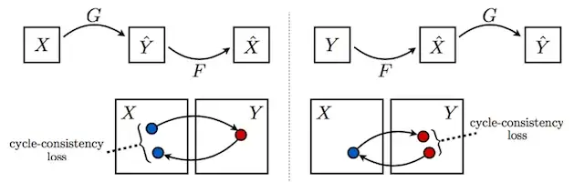
ET60029
Cycle GAN:
Image to Image Translation architecture
Consists of
Two mappings G : X -> Y and F : Y -> X
Corresponding Adversarial discriminators Dx and Dy
Loss
Generator Loss
Discriminator Loss
Cycle Consistency Loss

Slide 14
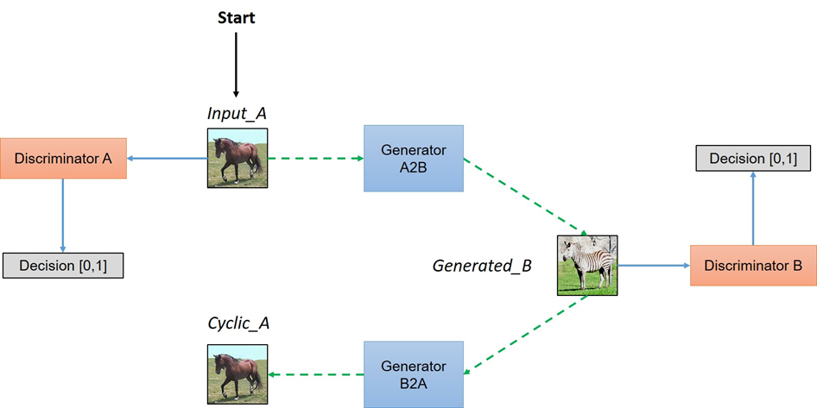
ET60029

Slide 15
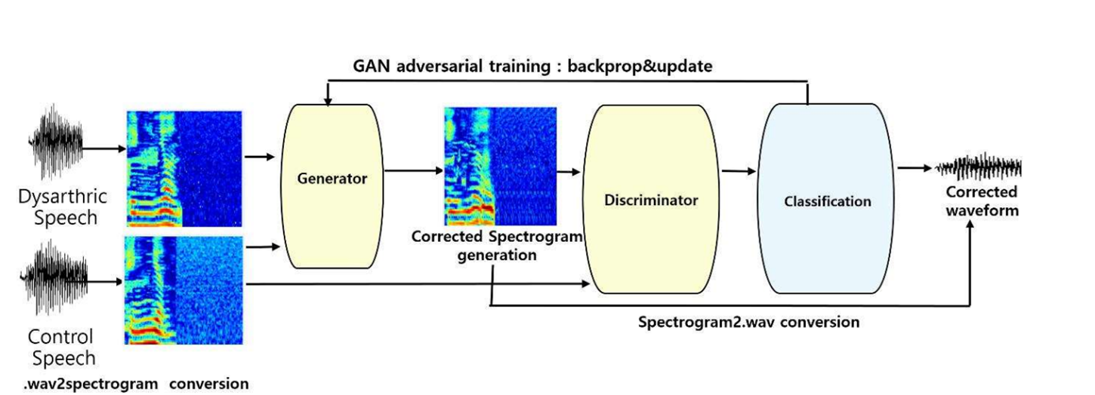
ET60029
Training Flow:

Slide 16
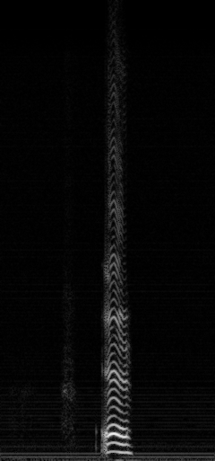
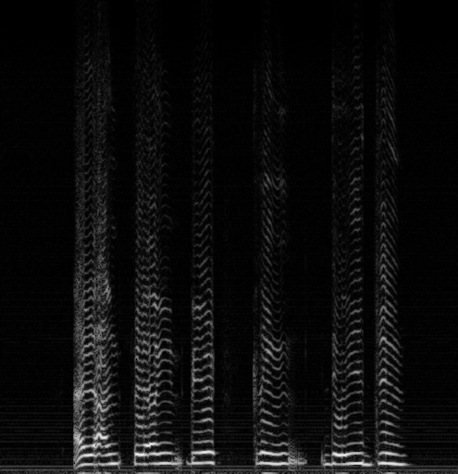

ET60029
Inference:
Input Mel Spectrogram
Generated Mel Spectrogram
Input Audio
Output Audio
Generator (netA2B)

Slide 17
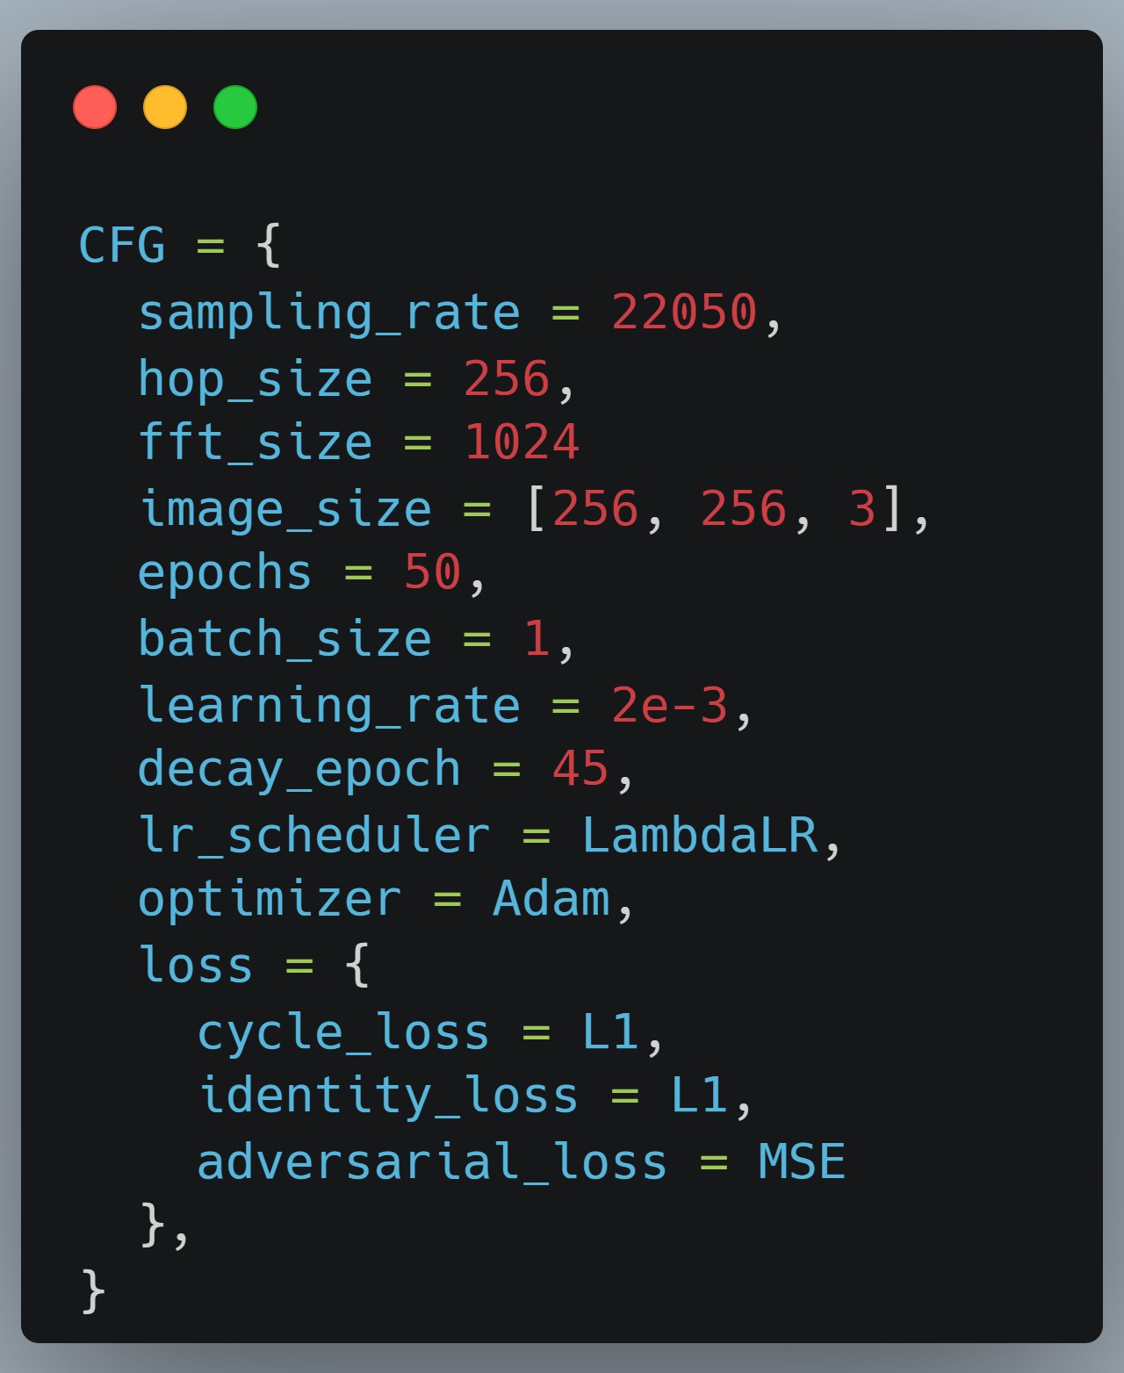
ET60029
Parameters setup:

Slide 18
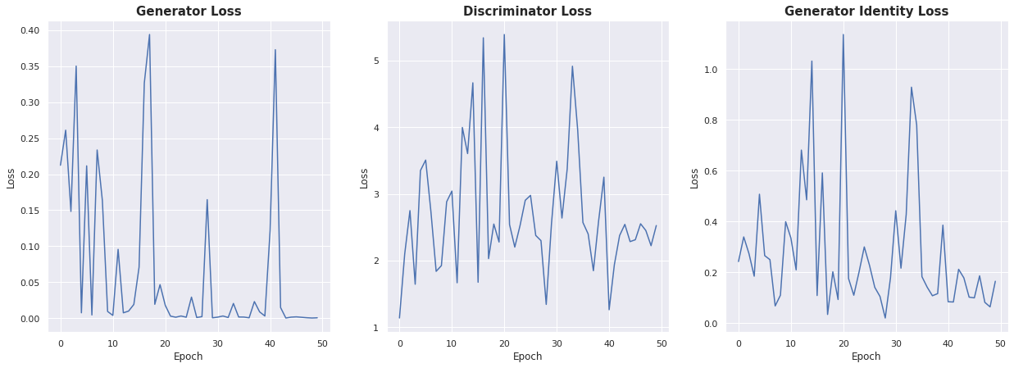
ET60029
Training Result:

Slide 19
DEPLOYMENT

Slide 20
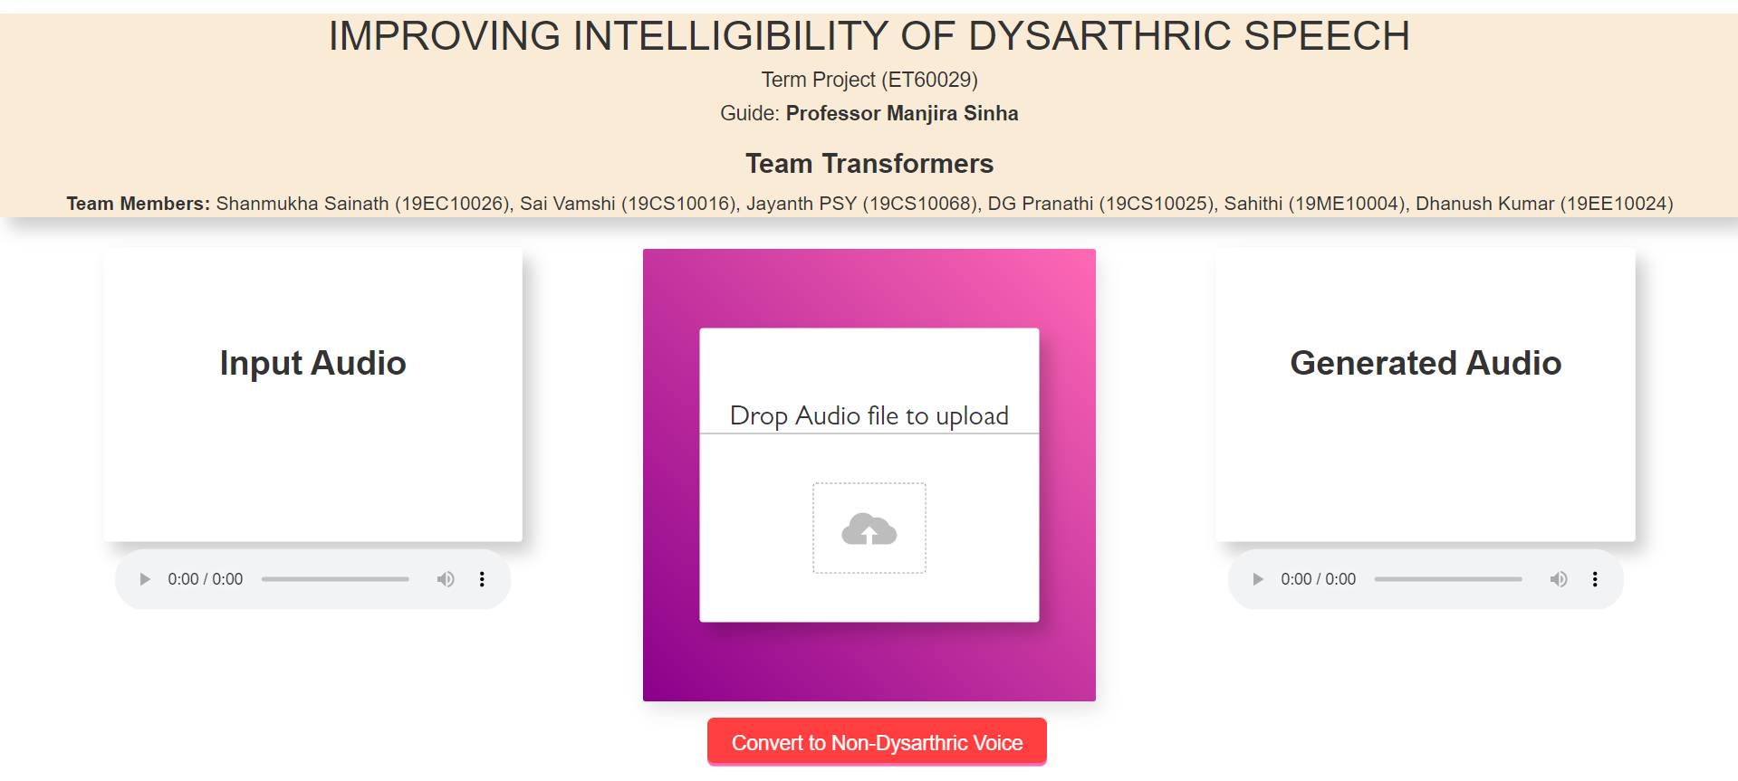
ET60029
Site Layout:

Slide 21
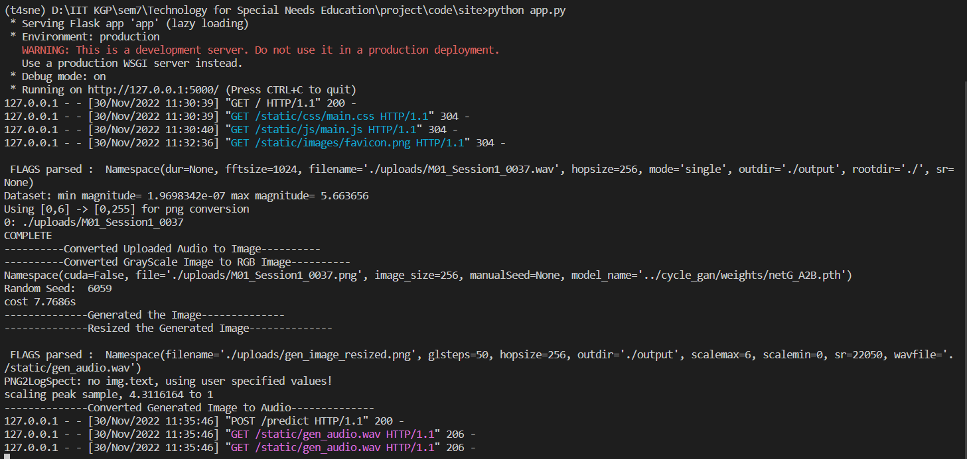
ET60029
Terminal Results:

Slide 22

REFERENCES

Slide 23
ET60029
Rudzicz, F., Namasivayam, A.K., Wolff, T. (2012) The TORGO database of acoustic and articulatory speech from speakers with dysarthria. Language Resources and Evaluation, 46(4), pages 523--541.
Zhu, Jun-Yan, et al. "Unpaired image-to-image translation using cycle-consistent adversarial networks." Proceedings of the IEEE international conference on computer vision. 2017.
Yang, Seung Hee, and Minhwa Chung. "Improving dysarthric speech intelligibility using cycle-consistent adversarial training." arXiv preprint arXiv:2001.04260 (2020).

